Slide 1
Bob Ostrander, MD
Past President, NYSAFP

Slide 2
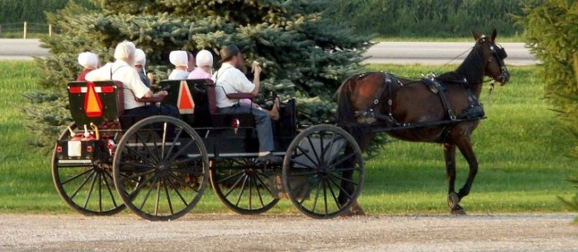
We’re lost again. Damn Map Quest. You should have printed out the map ya damn fool!

Slide 3
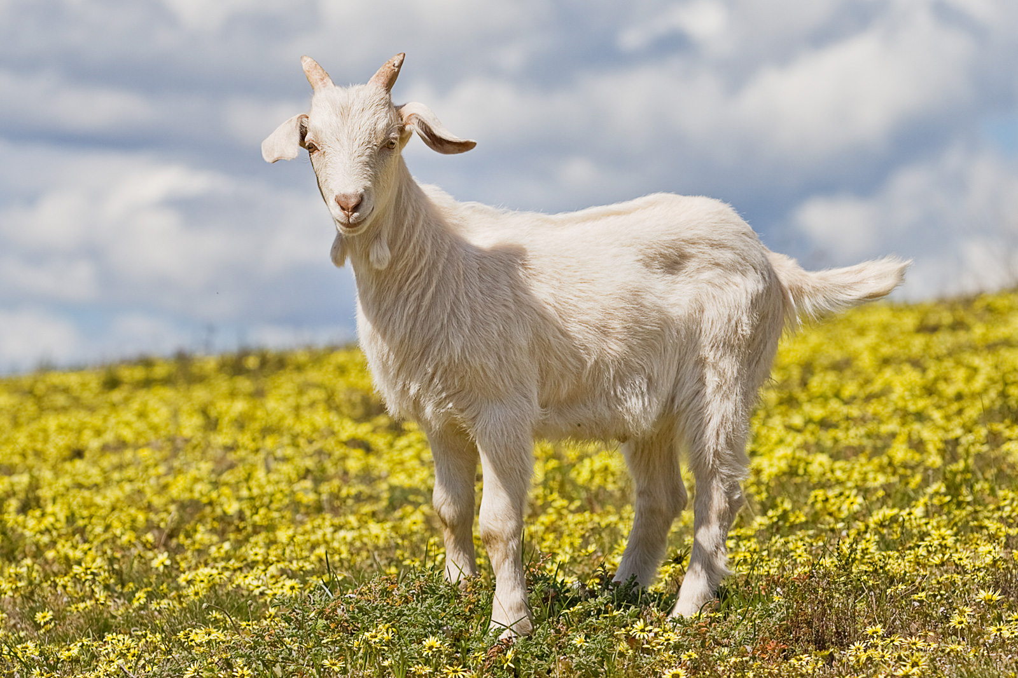
Got Milk? What the hell does that mean? Of course, I’ve got milk. I’m a damn goat. What else would I have.

Slide 4
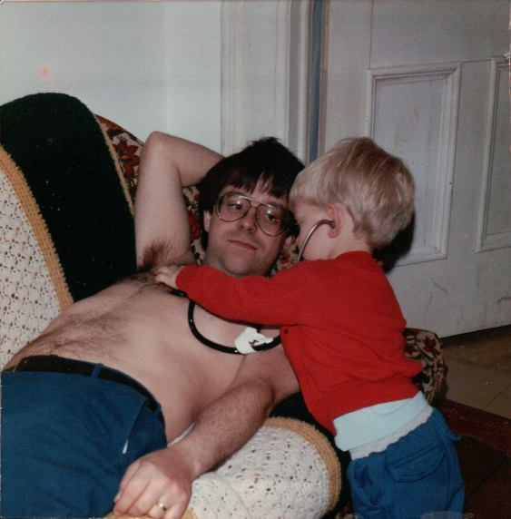
Uh oh. This doesn’t sound good, dad. I’m thinkin’ prostate. That’s around here, isn’t it?

Slide 5
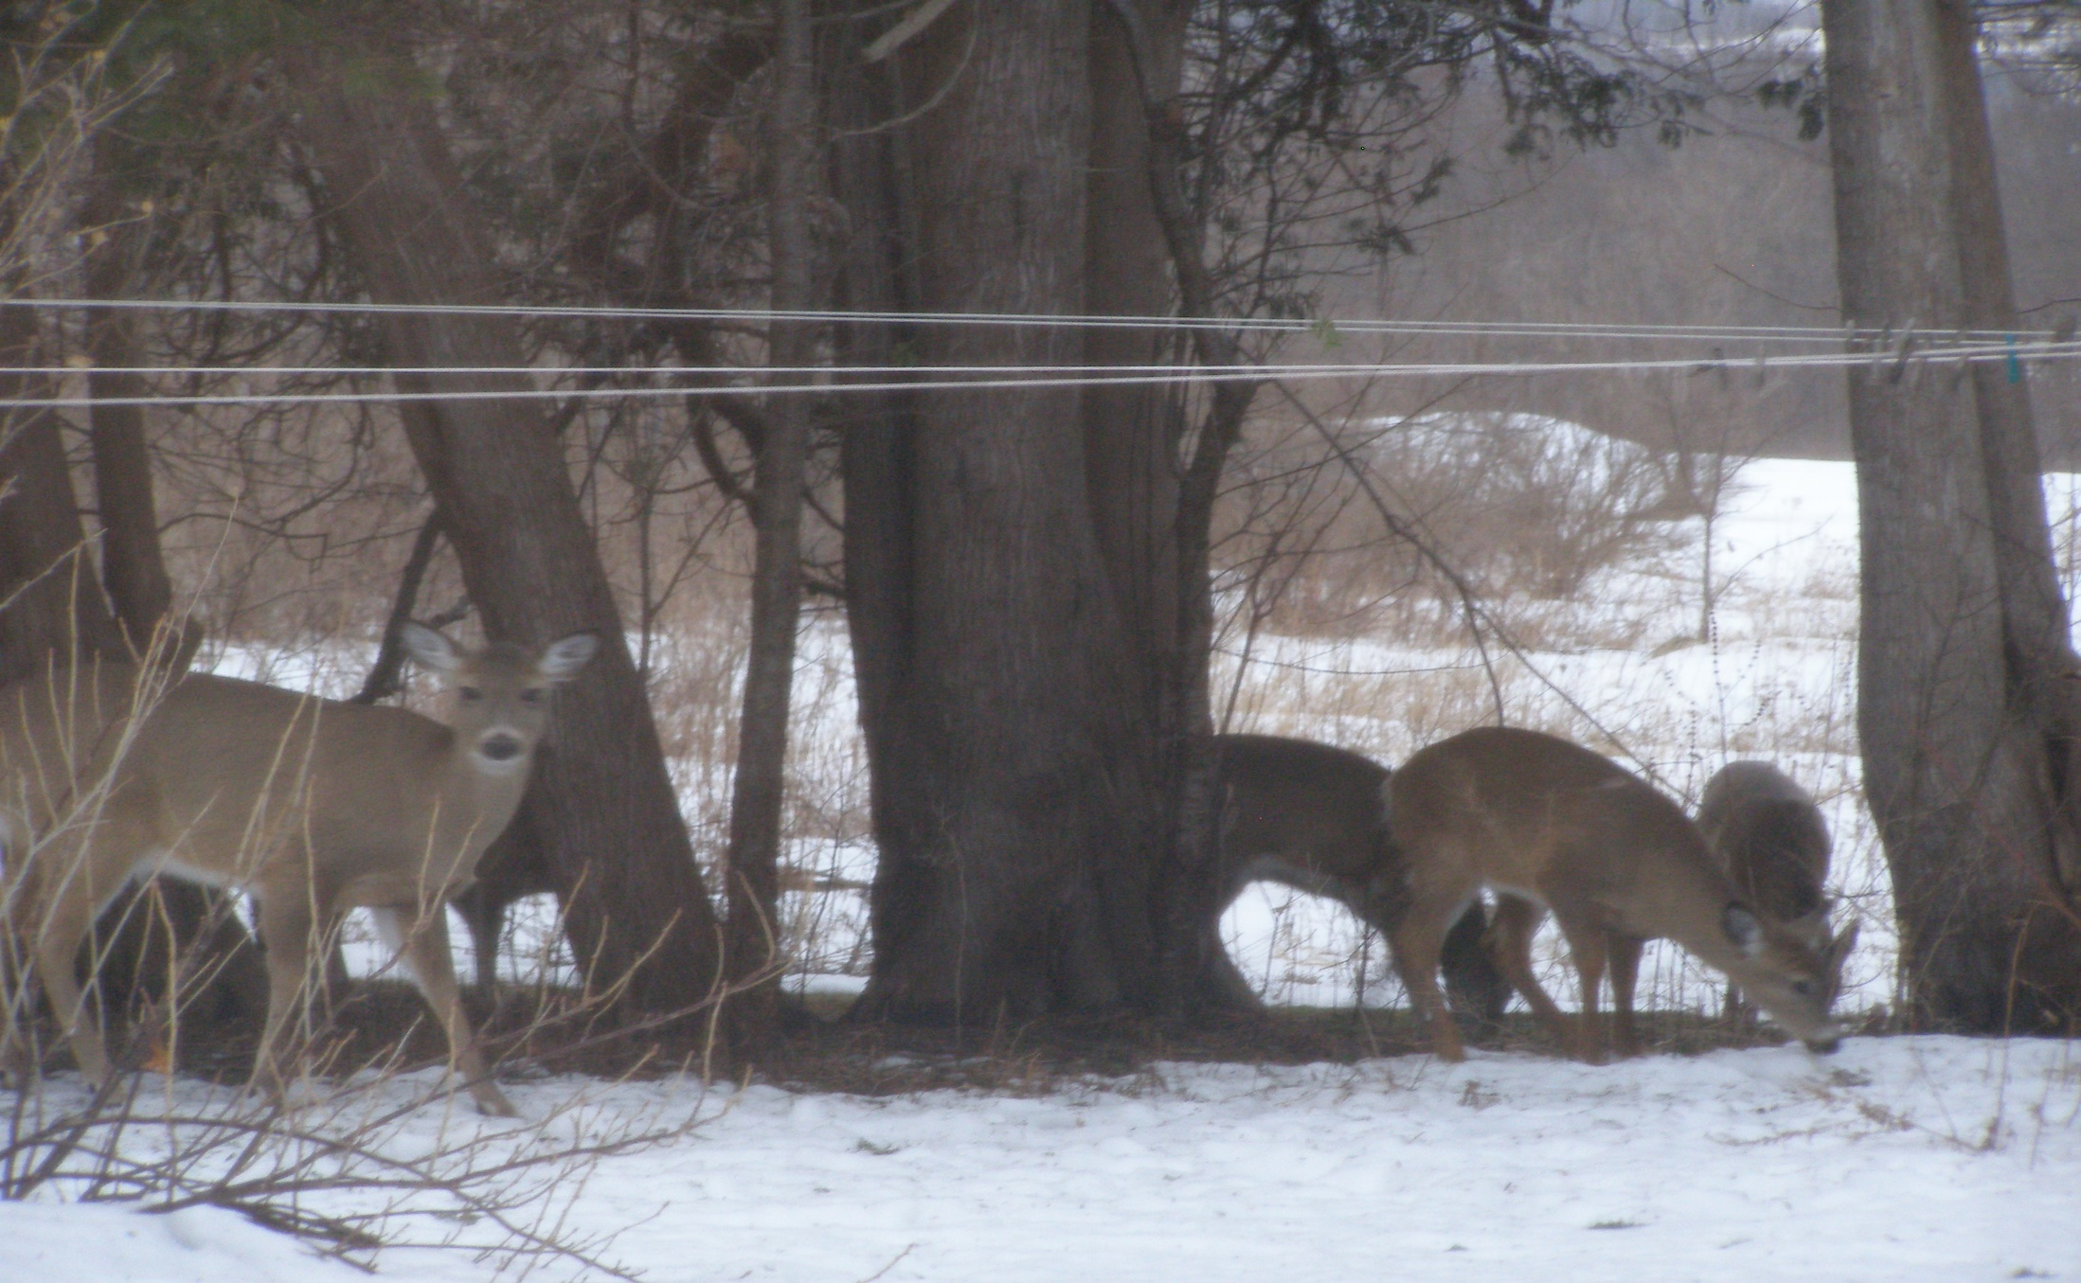
Am I next? Did you call “Doe” or “Joe”? I wasn’t paying attention. Dr. Phil has a celebrity guest.

Slide 6
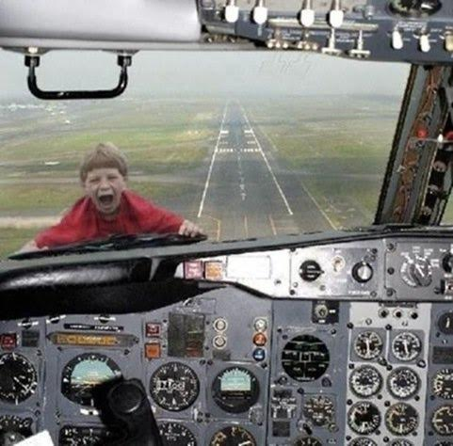
I’ll eat the damn vegetables! I swear I will!

Slide 7
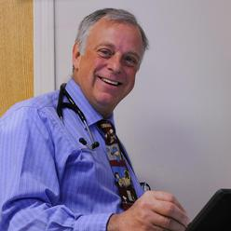
Bob Ostrander, MD – NYSAFP President, 2016-17

